Slide 1
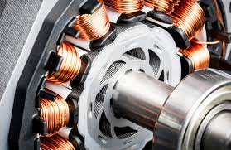
Brushless DC Motors
Name: Shreerang Mhatre
Rollno: 29
Batch: A2
Class: SY B.tech Electrical and Computer

Slide 2
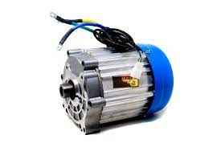
Contents:
Introduction
Working
Applications
Advantages
Disadvantages
Conclusion
References

Slide 3
Introduction: BLDC motors
A Brushless DC Motor, also known as a BLDC motor, is an electric motor that uses electronic commutation instead of brushes to switch the direction of the current in the windings. The rotor of a BLDC motor is made up of permanent magnets, while the stator contains the windings. When an electric current is applied to the windings, it creates a magnetic field that interacts with the permanent magnets in the rotor, causing it to turn.

Slide 4
Working:
The working principle of a BLDC motor involves the interaction of the magnetic fields created by the rotor magnets and the stator windings. As the current is switched in the stator windings, the magnetic field created by the windings interacts with the magnetic field created by the rotor magnets, causing the rotor to turn.
The Hall effect sensors provide information to the ECU about the position of the rotor magnets, so that the current can be switched at the right time. This allows the motor to run smoothly and efficiently.
Overall, the construction and working principle of a BLDC motor make it more efficient, reliable, and long-lasting compared to traditional brushed DC motors.

Slide 5
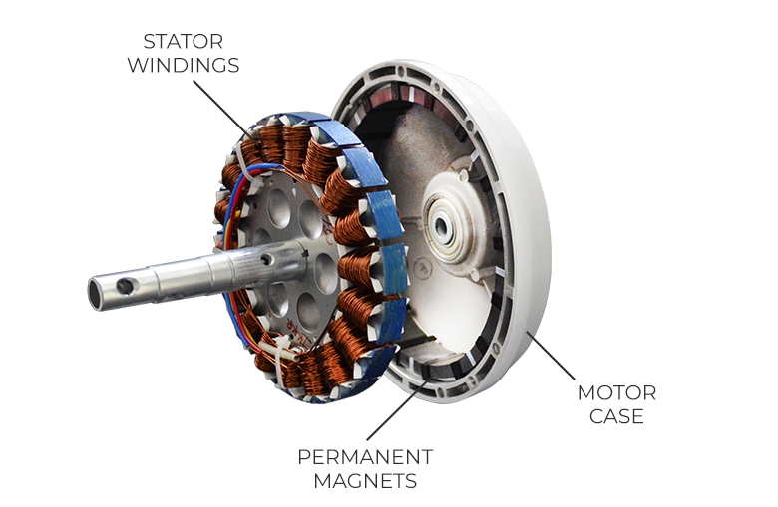
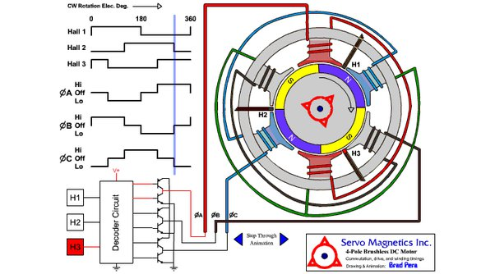
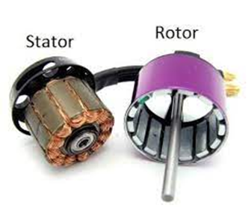
Construction and working:
BLDC motor

Slide 6
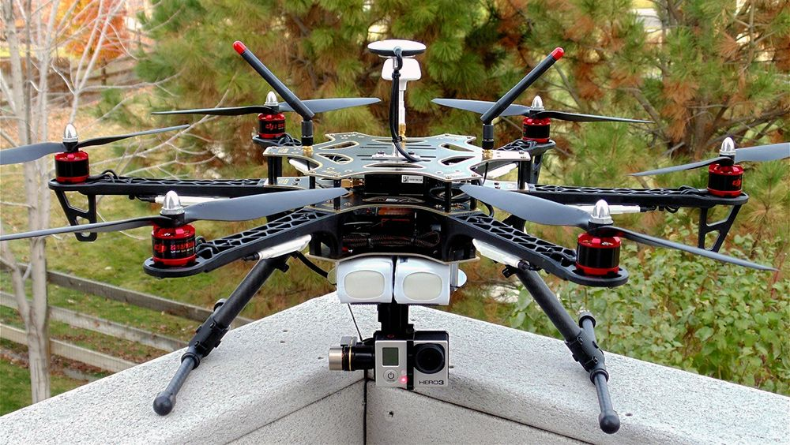
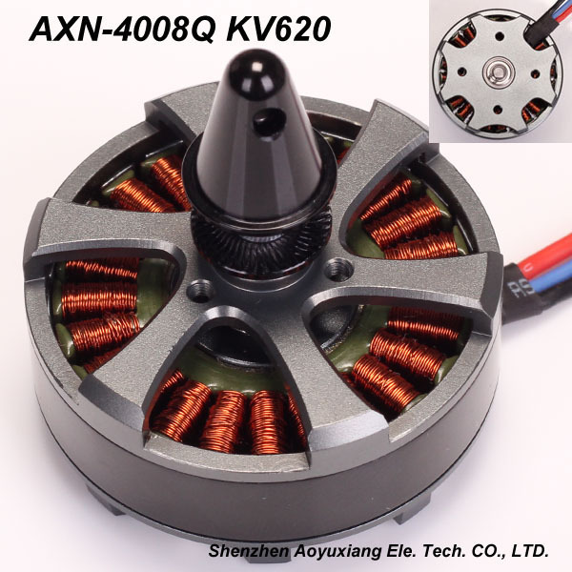
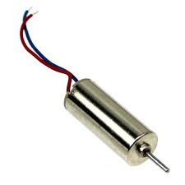
Applications:
Drones or UAVs
The main application of Brushless DC (BLDC) motors in drones is for propulsion, providing the lift needed to keep the drone in the air . BLDC motors are also used for stability control, maneuverability, and camera stabilization. Their high efficiency, power density, and precise control make them ideal for these applications.

Slide 7
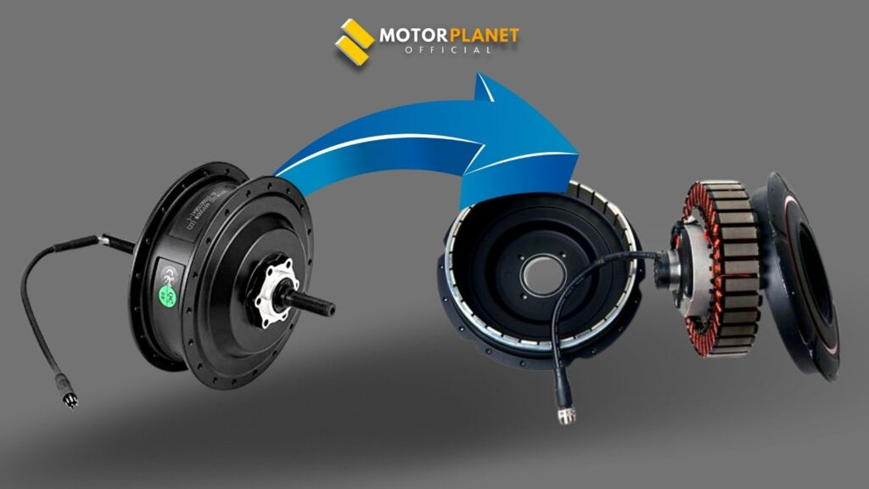
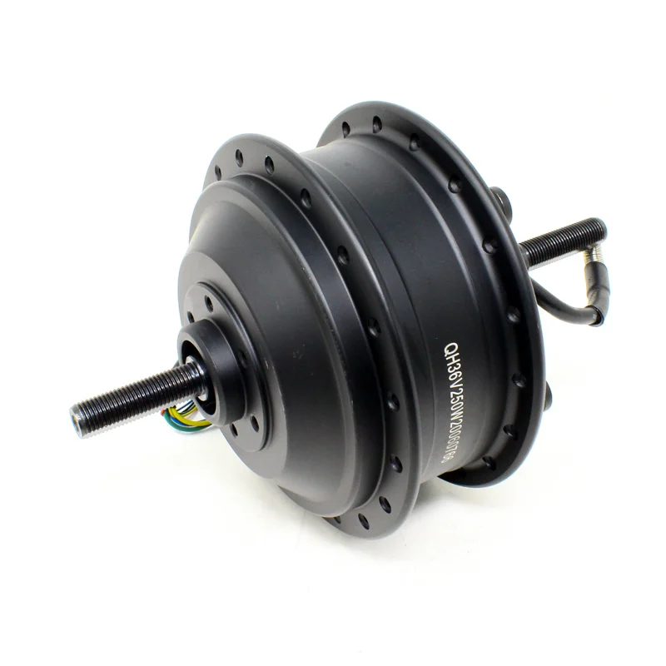

Electric Vehicles
BLDC (Brushless DC) motors are commonly used in Electric Vehicles (EVs)
due to their high efficiency, high power density, and low maintenance
requirements.
In an EV, the BLDC motor drives the wheels directly or through a
transmission The motor is powered by a battery pack, and the motor
controller manages the amount of current flowing through the motor to
control its speed and torque.
The use of BLDC motors in EVs provides a more efficient and
reliable propulsion system compared to traditional combustion engines,
making them an increasingly popular choice for modern electric vehicles.

Slide 8
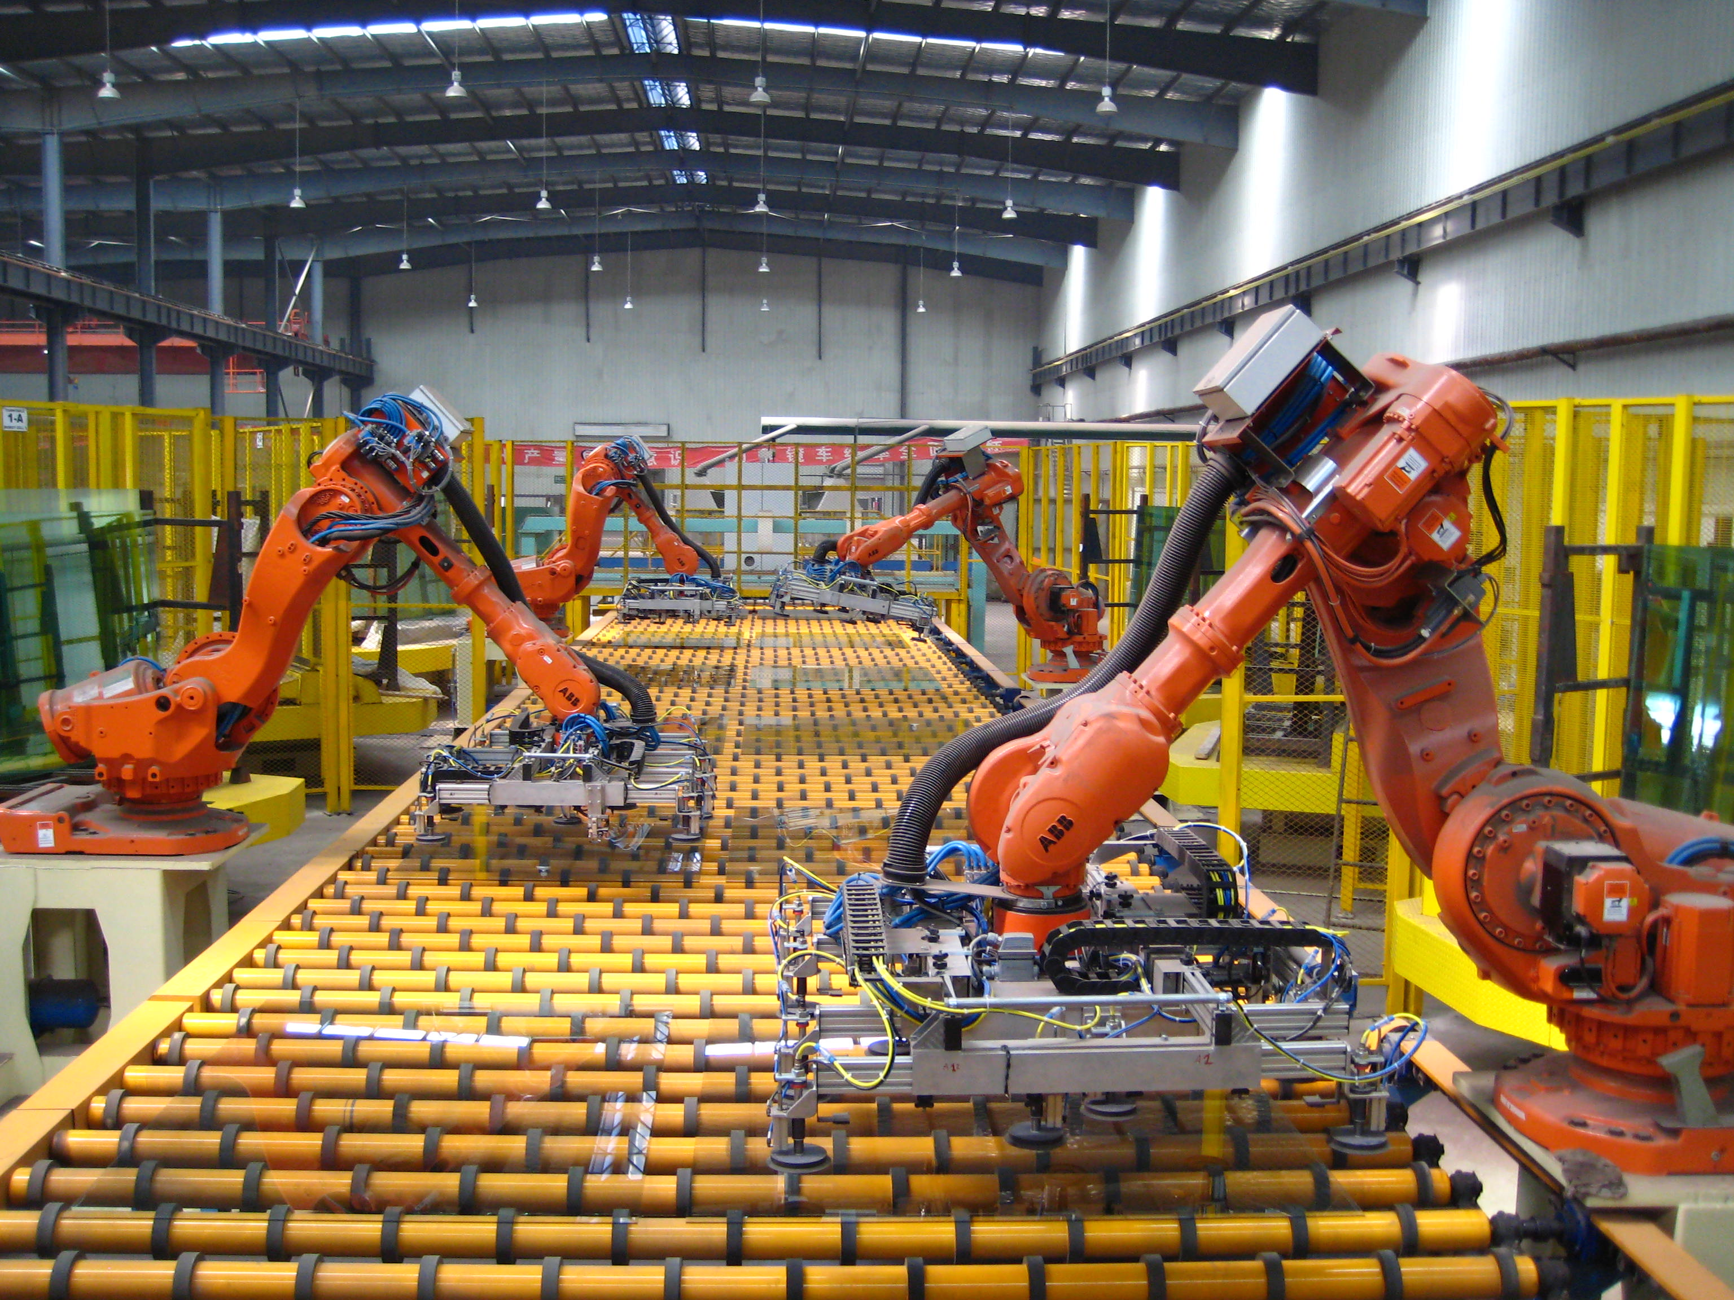
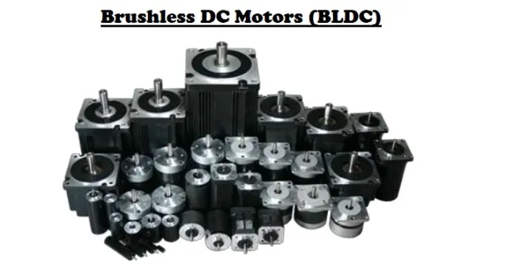
Industrial Automation
BLDC (Brushless DC) motors are commonly used in industrial automation due to their high power density, efficiency, and controllability.
In industrial applications, BLDC motors are often used in precision motion control systems, such as robotics, CNC machines, and automated assembly lines. They are also commonly used in pumps, fans, and other machinery that require continuous operation with high reliability and low maintenance.
The advantages of BLDC motors in industrial automation include high efficiency, low noise, precise speed and torque control, and longer lifespan compared to traditional motors. They can also operate in harsh environments, with resistance to dust, moisture, and vibration.
Overall, the use of BLDC motors in industrial automation provides a more efficient and reliable means of driving machinery, resulting in increased productivity and reduced operating costs.

Slide 9
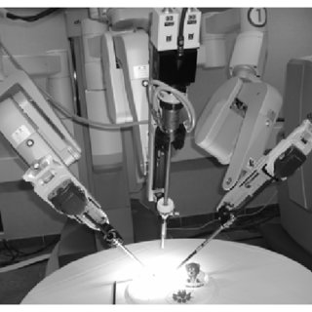

Medical Devices
In medical applications, BLDC motors are often used in equipment such as surgical robots, imaging systems, and infusion pumps. They are also used in devices such as electric wheelchairs, hospital beds, and lifts for patients with mobility impairments.
They are also compact and lightweight, making them suitable for use in portable and handheld medical devices.
The use of BLDC motors in medical devices provides a more efficient and reliable means of driving critical equipment, resulting in improved patient outcomes and reduced operating costs.

Slide 10
Advantages
Disadvantages
They are more efficient, reliable, and require less maintenance.
They also have higher torque, faster acceleration, and are quieter than traditional DC motors.
Brushless DC motors can also be designed to meet specific requirements, such as high torque, low speed, or high speed.
This makes them ideal for applications that require precise control and accuracy.
They are more expensive than traditional DC
motors, and require more complex control
systems.
They also require more power to
start and operate than traditional DC motors.
Brushless DC motors are also more
sensitive to changes in temperature and
humidity, which can affect their performance.
This makes them less suitable for
applications that require long-term
operation in harsh environments

Slide 11
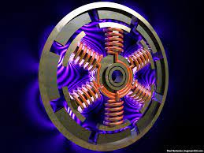
Conclusion
Brushless DC motors are a reliable, efficient, and cost
-effective alternative to traditional DC motors. They are
used in a wide range of applications, from consumer
electronics to industrial machinery. They are also more
energy efficient than traditional DC motors and can be designed to meet specific requirements.
Brushless DC motors have several advantages over
traditional DC motors, but they also have some drawbacks.
They are more expensive and require more power to start
and operate. They are also more sensitive to changes in
temperature and humidity.

Slide 12
References:
https://www.renesas.com/us/en/support/engineer-school/brushless-dc-motor-01-overview
https://en.wikipedia.org/wiki/Brushless_DC_electric_motor
https://www.magneticinnovations.com/faq/what-is-a-bldc-motor/
YT:
https://www.youtube.com/watch?v=yiD5nCfmbV0&ab_channel=TheEngineeringMindset
https://www.youtube.com/watch?v=bCEiOnuODac&ab_channel=Lesics
Research papers:
https://www.researchgate.net/publication/215686649_Development_of_a_BLDC_motor_drive_with_improved_output_characteristics
https://ijtre.com/wp-content/uploads/2021/09/2020070806.pdf
https://ieeexplore.ieee.org/document/6484349

Slide 13
Thankyou

